Slide 1
ALM – Overview of All Modules
Level – Practitioner
Press F11 to view this course in Full Screen
Notes:
Welcome to the session “ALM – Overview of All Modules”

Slide 2








Icons Used
Play
Pause
Replay
Audio On
Scroll Bar
Closed Captioning
Previous Slide
Next Slide
Exit
Notes:
The screen shows the icons used in the session for your easy reference.

Slide 3
Learning Objective
Learning Objectives
After completing this learning component, you will be able to:
ALM Tool – Overview
ALM supports through all phases of Application Life Cycle Management
Release and Test Cycle Management
Requirement Management and Test Planning
Test Execution and Defect Management
Explain the Analysis Overview.
Define Graphs.
Explain Excel Reports
Data Analysis via reporting and Dashboard Feature of ALM
What is HP Sprinter
Test Execution
Screen Annotation & Tools
Defect logging from Sprinter
Power Mode Features
Indicates the topic in discussion
Indicates the topics to be covered
Indicates the topics covered
Notes:
The topic ‘Introducing Analysis’ will give you brief an introduction to analysis before get to know what the different analysis tools and their usages are.

Slide 4
Learning Objective
Learning Objectives
After completing this learning component, you will be able to:
ALM Tool – Overview
ALM supports through all phases of Application Life Cycle Management
Release and Test Cycle Management
Requirement Management and Test Planning
Test Execution and Defect Management
Explain the Analysis Overview.
Define Graphs.
Explain Excel Reports
Data Analysis via reporting and Dashboard Feature of ALM
What is HP Sprinter
Test Execution
Screen Annotation & Tools
Defect logging from Sprinter
Power Mode Features
Indicates the topic in discussion
Indicates the topics to be covered
Indicates the topics covered
Notes:
The topic ‘Introducing Analysis’ will give you brief an introduction to analysis before get to know what the different analysis tools and their usages are.

Slide 5
ALM Tool - Overview
What is ALM?
Application Life Cycle Management Tool (ALM) supports all phases of the software development life cycle along with test management. Previously, it was popularly known as HP Quality Center.
History of ALM :
Tool Name | Version Number(s) | Owned By
ALM | V 11.0 to V 12.x | Hewlett Packard
Quality Center | V 9.2 to V 10.0 | Hewlett Packard
Quality Center | V 8.0 to V 9.0 | Mercury Interactive
Test Director | V 1.52 to V 8.0 | Mercury Interactive
Notes:
Speaker Notes ;
Before we get to the features/capabilities of ALM. Let me briefly tell you what is ALM and also about its history.
ALM stands for Application Life Cycle Management.
ALM Tool is also called as application lifecycle management / Quality Center and it helps you to organize and manage all phases of the application life cycle management process, including defining releases, specifying requirements , planning tests, executing tests and tracking defects.
The first version of ALM was named Test Director and it was released by Mercury Interactive. After the release of Test Director version 8.0, there were no releases of Test Director. Test Director was released with another name ‘Quality Center’ starting with the same version 8.0.
In the year 2006, Mercury Interactive got acquired by Hewlett Packard and thus, from then on Quality Center was prefixed with HP and not Mercury.
After Quality Centre 10, it underwent a change in name again so that it can be better related to the name. From version 11, ALM is the new name of the tool because, it supports all phases of software development life cycle but previously when it was popularly called Quality Center, it used to be only known as a Test Management Tool
The most recent version of ALM available in the market is 12.00.

Slide 6
Learning Objective
Learning Objectives
After completing this learning component, you will be able to:
ALM Tool – Overview
ALM supports through all phases of Application Life Cycle Management
Release and Test Cycle Management
Requirement Management and Test Planning
Test Execution and Defect Management
Explain the Analysis Overview.
Define Graphs.
Explain Excel Reports
Data Analysis via reporting and Dashboard Feature of ALM
What is HP Sprinter
Test Execution
Screen Annotation & Tools
Defect logging from Sprinter
Power Mode Features
Indicates the topic in discussion
Indicates the topics to be covered
Indicates the topics covered
Notes:
The topic ‘Introducing Analysis’ will give you brief an introduction to analysis before get to know what the different analysis tools and their usages are.

Slide 7
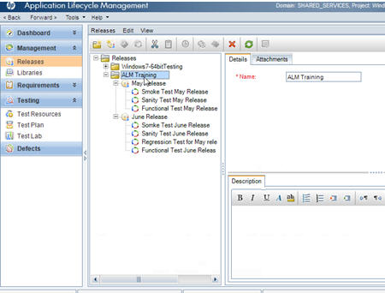
ALM Capabilities - Release and Test Cycle Management
Release and Test Cycle Management :
ALM facilitates control of development and testing cycles, breaking large projects into manageable phases. Providing the ability to track requirements, tests for each cycle, and attain real-time visibility into actual versus planned testing status.
Release
Cycle
Notes:
Speaker Notes
Here, you will learn how to use ALM to help you manage all phases of the application lifecycle management process
This includes specifying releases and cycles, specifying requirements, planning tests, running tests and tracking defects.
Application lifecycle management process begins with specifying releases and cycles. You can then add cycles to the release.
By defining releases and cycles, ALM facilitates control of your development and testing cycles, breaking large projects into managing phases.
Here, you can organize and track your upcoming releases by defining a hierarchical release tree containing releases and cycles.
The above figure depicts how you can specify releases and cycles in ALM

Slide 8
ALM Capabilities - Release and Test Cycle Management
Release and Test Cycle Management :
Notes:
Speaker Notes :
In the above figure ,You can view the status of your releases and cycles.
ALM shows a high-level overview of the progress of the currently selected release or cycle.
It also shows the number of defects opened over the course of the currently selected release or cycle. You can also view the number of outstanding defects.
Thus in the process, It also provides the ability to track requirements and tests for each cycle and attain real-time visibility into actual versus planned testing status.

Slide 9
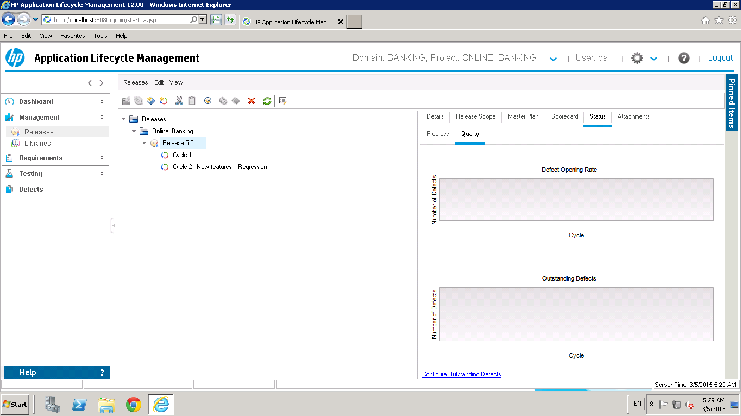
ALM Capabilities - Release and Test Cycle Management
Release and Test Cycle Management :
Notes:
The Quality tab displays the number of defects submitted over the course of a release or cycle in graphical format. You can view the graphs at
Defect Opening Rate Graph and
Outstanding Defects Graph
any stage of the application management process to check the progress of your release.
Defect Opening Rate graph - Displays the number of defects opened over the course of the selected release or cycle . The graph displays defects whose Detected in Release value matches the selected release. The defects are grouped according to their level of Severity. The x-axis displays the number of defects according to their severity on the last day of each release.
Outstanding Defects graph - Displays the number of outstanding defects for the selected release or cycle.
The graph displays defects whose Target Release value matches the selected release or cycle, or is empty. The defects are grouped according to their level of Severity. The x-axis displays the number of outstanding defects according to their severity on the last day of each Release. By default, New, Open, and Reopened defects are considered outstanding.

Slide 10
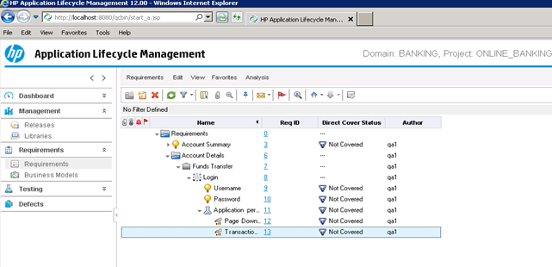
ALM Capabilities - Requirements Management
Requirements Management :
ALM defines, manages, and tracks requirements at all stages of the application lifecycle management. Requirements describe what needs to be achieved to meet the objectives of the application undergoing development.
Requirements Folder
Business Requirements
Group
Functional Requirements
Testing Requirements
Performance Requirements
Notes:
Speaker Notes :
Here, you will learn about how ALM can be used for Requirements Management.
Requirements describe in detail what needs to be achieved to meet the objectives of the application under development.
Requirements can be of different types as specified in the requirement tree namely business requirements, functional requirements, testing requirements, performance requirements and group requirements.
You define the requirements for a release cycle in ALM by creating a requirements tree in the requirement module.
This is a hierarchical representation of your requirements.
You can group and sort requirements in the tree, monitor the progress in meeting requirements and generate detailed reports and graphs .
You will then assign the requirements to a cycle in the release tree.
You will also learn how to convert requirements to tests.
Thus, ALM defines, manages and track requirements at all stages of the application lifecycle management.

Slide 11
ALM Capabilities – Test Planning
Test Planning :
ALM defines, manages, and tracks functional, performance, and security test scripts in one place. It assigns business risk to requirements, and calculates where to apply testing resources. QA teams can emulate business processes, run tests unattended with QTP, and execute manual or automated tests.
Test Cases
Test Steps
Notes:
After you define requirements, you need to determine your testing goal and outline the strategy for achieving your goal.
After you determine your testing goal, you build a test plan tree, which hierarchically divides your application into testing units, or subjects. You can refer to the figure on the left side on how you can build a test plan tree.
For each subject, in the test plan tree , you define tests that can steps. For each test step, you specify the actions to be performed on your application and the expected result. You can refer to the figure on the right side on how you can define your test steps for a specific test.
ALM enables you to use the same test to test different use-cases, each with its own test configuration.
It is essential that the tests in your test plan comply with your requirements.
To help ensure compliance throughout the application lifecycle management process, add coverage between tests and requirements.
Thus, ALM defines, manages and tracks functional, performance and security test scripts in one place.
Test planning involves deciding which tests to automate.
If you choose to execute tests manually, the tests are ready for execution as soon as you define the test steps. If you choose to automate tests, you can generate test scripts and complete them using other HP testing tools (for example, QuickTest Professional).

Slide 12
ALM Capabilities – Test Execution
Test Execution :
ALM supports manual and automated testing (with QTP), including unattended execution. It provides views of execution runs, results ,and log defects. When integrated with automaton tools such as QTP, user will have the capability to manage all types of testing from one location.
Test Status
Manual Test Execution
Test Set
Automation Test Execution
Test Step Status
Notes:
Throughout the application lifecycle management process, you can run manual and automated tests to locate defects and assess the quality of your application.
You start by creating test sets and choosing which tests to include in each set. A test set contains a subset of the tests in an ALM project designed to achieve specific test goals. ALM enables you to control the execution of tests in a test set by setting conditions and scheduling the date and time for executing your tests.
After you define test sets, you can begin to execute your tests. You can then use ALM to view and analyze the results of your tests.
When you run a test manually, you execute the test steps you defined in test planning.
You pass or fail each step, depending on whether the actual results match the expected output.
When you run a test automatically, ALM opens the selected testing tool, which runs the test, and imports the test results to ALM.
Thus, ALM supports manual and automated testing (with QTP) including unattended execution.
It provides views of execution runs, results and log defects.
When integrated with automaton tools such as QTP, you will have the capability to manage all of your testing one central location

Slide 13
ALM Capabilities – Defect Management
Defect Management :
ALM Defect Management identifies, manages, tracks, and enforces defect resolution. It does not require a specific defect management methodology, but it does require basic planning and organization. The ability to customize workflow gives users the ability to map the process to his real life environment.
Notes:
Locating and repairing defects is an essential phase in application development.
Defects can be detected and submitted by users in all stages of the application lifecycle management process. Using HP Application Lifecycle Management (ALM), you can submit defects detected in the application and track them until they have been repaired and retested.
Thus, ALM Defect Management identifies, manages, tracks and enforces defect resolution.

Slide 14
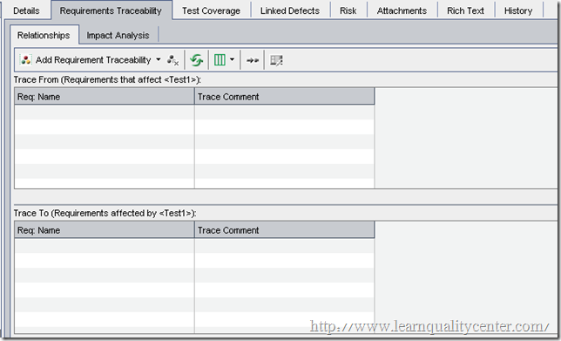
ALM Capabilities – Maintain Requirement Traceability
Maintain Requirement Traceability :
Trace From
Trace To
Notes:
Requirements traceability defines a relationship between two or more requirements. When analyzing the impact of a change proposed in a specific requirement, the traceability links indicate the other requirements that the change might affect.
You can add traceability links to and from a selected requirement.
Trace from links indicate requirements that affect a selected requirement.
Trace to links indicate requirements that are affected by a selected requirement.
Thus, this feature will help you how to define traceability links between requirements and to view association or dependencies that exist between the dependencies
The traceability matrix enables you to determine the extent of relationships between requirements and other requirements and between requirements and tests. It helps you verify that all requirements are met and identify changes to the scope of your requirements when they occur.
The traceability matrix lists source requirements and their associated requirements and tests.
In the Traceability Matrix, you can view, analyse and review the traceability links between requirements and the links between requirements and tests

Slide 15
ALM Capabilities – Requirement Traceability
Requirement Traceability :
Trace From
Trace To
Notes:
Requirements traceability defines a relationship between two or more requirements. When analyzing the impact of a change proposed in a specific requirement, the traceability links indicate the other requirements that the change might affect.
You can add traceability links to and from a selected requirement.
Trace from links indicate requirements that affect a selected requirement.
Trace to links indicate requirements that are affected by a selected requirement.
Thus, this feature will help you how to define traceability links between requirements and to view association or dependencies that exist between the dependencies

Slide 16
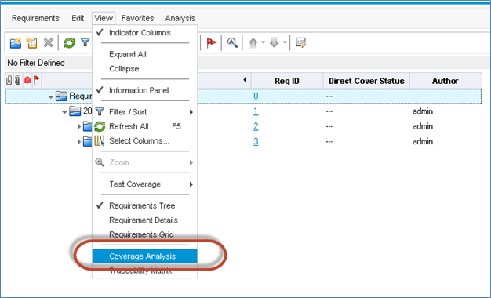
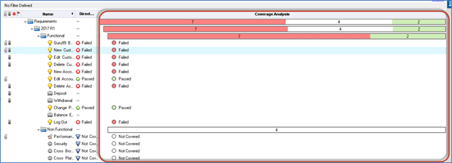
ALM Capabilities – Coverage Analysis
Coverage Analysis :
Notes:
You can create coverage by linking requirements to tests. You can create coverage from the Requirements or the Test Plan module. Once the user has mapped all the requirements, tests and defects, you will be able to generate coverage analysis which is one of the perquisites to generate traceability Matrix.
Coverage Analysis helps us to understand the test coverage against a specific requirement and details about number of tests passed/failed/not executed.

Slide 17
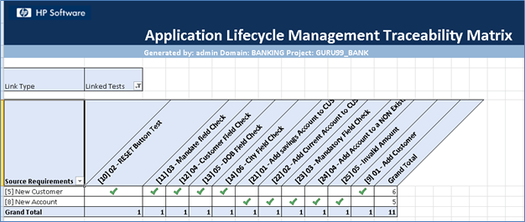
ALM Capabilities – Requirement Traceability Matrix
Requirement Traceability Matrix :
Notes:
The traceability matrix enables you to determine the extent of relationships between requirements and other requirements and between requirements and tests. It helps you verify that all requirements are met and identify changes to the scope of your requirements when they occur.
The traceability matrix lists source requirements and their associated requirements and tests.
In the Traceability Matrix, you can view, analyse and review the traceability links between requirements and the links between requirements and tests

Slide 18
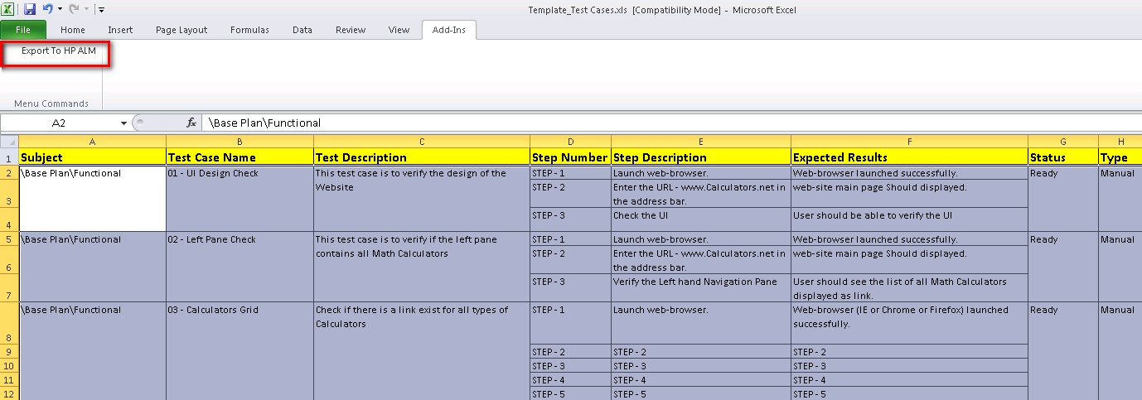
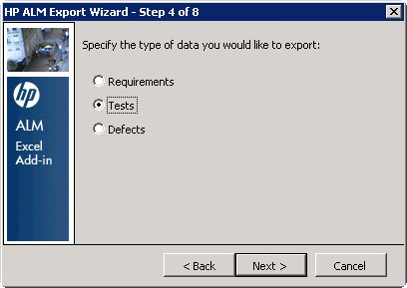
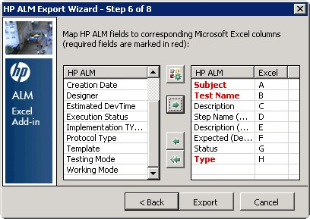
ALM Capabilities – Upload Tests from Excel to ALM
Uploading Tests from Excel to ALM :
Notes:
You can create tests manually in ALM. Another approach creating tests in ALM is to upload tests from MS Excel to ALM.
Thus, You can upload the tests created for the project requirements in the Test Plan Tab. Thus requires, you to have the Microsoft Excel Add In installed. Not all versions of Excel are supported. Use supported versions of MS Excel to use this feature.
After the Add-In is installed, you can see the option ‘Export to ALM’ button under AddIns tab in Excel.
Create a Test Map and map the fields of MS Excel and ALM to enable export of tests from Excel to ALM
Apart from Upload of tests from excel to ALM, you can also upload requirements / defects from excel to ALM using similar procedure.

Slide 19
Learning Objective
Learning Objectives
After completing this learning component, you will be able to:
ALM Tool – Overview
ALM supports through all phases of Application Life Cycle Management
Release and Test Cycle Management
Requirement Management and Test Planning
Test Execution and Defect Management
Explain the Analysis Overview
Define Graphs Analysis
Explain Excel Reports
Data Analysis via reporting and Dashboard Feature of ALM
What is HP Sprinter
Test Execution
Screen Annotation & Tools
Defect logging from Sprinter
Power Mode Features
Indicates the topic in discussion
Indicates the topics to be covered
Indicates the topics covered
Notes:
The topic ‘Introducing Analysis’ will give you brief an introduction to analysis before get to know what the different analysis tools and their usages are.

Slide 20
Introducing Analysis Overview
Introducing Analysis
ALM reports and graphs helps to assess your application lifecycle management process. You can generate reports and graphs at any time during the process.
Project reports enables you to design and generate versatile reports containing information from the ALM project.
You can create graphs or project reports either in the Analysis View module, or during your work in the Requirements, Test Plan, Test Lab, Business Components, or Defects modules. In either case, you can save the graphs and reports in the Analysis View module for future reference.
Dashboard View module helps to analyse ALM data by creating graphs, project reports and Excel Reports. you can also create dashboard pages that display multiple graphs side-by-side.
Notes:
Introducing Analysis
ALM reports and graphs helps to assess your application lifecycle management process. You can generate reports and graphs at any time during the process.
Project reports enables you to design and generate versatile reports containing information from the ALM project.
You can create graphs or project reports either in the Analysis View module, or during your work in the Requirements, Test Plan, Test Lab, Business Components, or Defects modules. In either case, you can save the graphs and reports in the Analysis View module for future reference.
Dashboard View module helps to analyse ALM data by creating graphs, project reports and Excel Reports. you can also create dashboard pages that display multiple graphs side-by-side.

Slide 21
Learning Objective
Learning Objectives
After completing this learning component, you will be able to:
ALM Tool – Overview
ALM supports through all phases of Application Life Cycle Management
Release and Test Cycle Management
Requirement Management and Test Planning
Test Execution and Defect Management
Explain the Analysis Overview
Define Graphs Analysis
Explain Excel Reports
Data Analysis via reporting and Dashboard Feature of ALM
What is HP Sprinter
Test Execution
Screen Annotation & Tools
Defect logging from Sprinter
Power Mode Features
Indicates the topic in discussion
Indicates the topics to be covered
Indicates the topics covered
Notes:
Learning Objective

Slide 22
Graphs Analysis
Graphs Analysis
ALM graphs helps you analyse and view the relationships between different types of data.
You can create the following types of graphs in ALM:
Entity Graphs
Business View Graphs
In Entity Graph, each graph is based on a single entity only such as requirements , tests or defects and enables you to view any of the entity’s attributes
In Business View Graph, each graph is based on a business view i.e., reflects business value information only that can represent either a single entity such as requirements which others can represent more complex relationship between multiple entities (for example, defects, requirements, and tests) , such as Defects with Linked Requirements.
Business View Graphs ensures a standardization across graphs. Different graphs based on the same business view reflect a common frame of reference. This provides genuine business value to the reports consumer, thereby making the reports more meaningful.
ALM provides a set of pre-defined business views that are available for selection. Business View graphs are always the Summary graph type.
Notes:
ALM graphs help you analyse and view the relationships between different types of data.
You can create the following types of graphs in ALM, Entity Graphs and Business View Graphs.
In Entity Graph, each graph is based on a single entity only such as requirements, tests or defects and enables you to view any of the entity’s attributes.
In Business View Graph, each graph is based on a business view, that is , reflects business value information only that can represent either a single entity such as requirements which others can represent more complex relationship between multiple entities (For Example: defects, requirements, and tests), such as Defects with Linked Requirements.
Business View Graphs ensures a standardization across graphs. Different graphs based on the same business view reflect a common frame of reference. This provides genuine business value to the reports consumer, thereby making the reports more meaningful.
ALM provides a set of pre-defined business views that are available for selection. Business View graphs are always the Summary graph type.

Slide 23
Analysis using Graphs – Entity Graph Types
Entity Graph:
ALM enables users to generate graphs for requirements, tests, test instances, test runs or defects. When creating an entity graph, you can use several graph types. For each entity, different graph types are available that are listed below.
Entity Types | Requirement | Test Plan | Test Lab/Test Run | Defects
Graph Types | Requirements Coverage Graph | Test Plan Progress Graph | Test Set Progress Graph | Defects Age Graph
 | Requirements Progress Graph | Test Plan Summary Graph | Test Set Summary Graph | Defects Progress Graph
 | Requirements Summary Graph | Test Plan Trend Graph | Test Run Summary Graph | Defects Summary Graph
 | Requirements Trend Graph |  |  | Defects Trend Graph
Notes:
Now, let’s learn more in detail about Entity Graphs.
With Entity Graphs, ALM enables users to generate graphs for requirements, tests, test instances, test runs or defects. When creating an entity graph, you can use several graph types.
For each entity, different graph types are available.
You can generate the following graphs for requirements :
Requirements Coverage Graph
Requirements Progress Graph
Requirements Summary Graph
Requirements Trend Graph
You can generate the following graphs for Tests:
Test Plan Progress Graph
Test Plan Summary Graph
Test Plan Trend Graph
You can generate the following graphs for test instances and runs
Test Set Progress Graph
Test Set Summary Graph
Test Run Summary Graph
You can generate the following graphs for Defects
Defects Age Graph
Defects Progress Graph
Defects Summary Graph
Defect Trend Graph

Slide 24
Analysis using Graphs – Entity Graph Types (Contd.)
Requirement Graphs:
Graphs | Description
Requirements Coverage Graph | Shows how requirements are currently in an ALM project according to their test coverage status.
Requirements Progress Graph | Shows how many requirements accumulated in an ALM project at specific points during a period of time.
Requirements Summary Graph | Shows how many requirements are currently in an ALM project.
Requirements Trend Graph | Shows the history of changes to specific requirement fields in an ALM project, for each time interval displayed.
Notes:
You can generate the following graphs for Requirement Graphs. Let us understand the utility of each of the graphs. This is available from the requirement module only.
Requirements Coverage graph shows how many requirements are present currently in an ALM project according to their test coverage status.
Requirement Progress Graph shows how many requirements are accumulated in an ALM project at specific points during a period of time
Requirements Summary Graph shows how many requirements are currently in an ALM Project
Requirements Trend Graph shows the history of changes to specific requirement fields in an ALM project, for each time interval displayed.

Slide 25
Analysis using Graphs – Entity Graph Types (Contd.)
Test Plan Graphs:
Graphs | Description
Test Plan Progress Graph | Shows how many tests accumulated in an ALM project at specific points during a period of time.
Test Plan Summary Graph | Shows how many tests are currently in an ALM project.
Test Plan Trend Graph | Shows the history of changes to specific Test Plan fields in an ALM project, for each time interval displayed.
Test Instance/ Run Graphs:
Graphs | Description
Test Set Progress Graph | Shows how many test sets accumulated in an ALM project at specific points during a period of time.
Test Set Summary Graph | Shows how many tests in an ALM project belong to test sets.
Test Run Summary Graph | Shows the status of runs in the project, grouped by Tester.
Notes:
You can generate the following graphs for Tests. Let us understand the utility of each of the graphs.
Test Plan Progress Graph shows how many tests are accumulated in an ALM project at specific points during a period of time..
Test Plan Summary Graph shows how many tests are currently present in an ALM project.
Test Plan Trend Graph shows the history of changes to specific Test Plan fields in an ALM project, for each time interval displayed.
You can also generate the following graphs for Test Instances and Test Runs.
Test Set Progress Graph shows how many test sets are accumulated in an ALM project at specific points during a period of time
Test Set Summary Graph shows how many tests in an ALM project belong to test sets
Test Run Summary Graph shows the status of runs in the project grouped by Tester.

Slide 26
Analysis using Graphs – Entity Graph Types (Contd.)
Defects Graphs:
Graphs | Description
Defects Age Graph | Shows the lifetime of defects in an ALM project. The lifetime of a defect begins when it is reported, and ends when it is closed.
Defects Progress Graph | Shows the accumulation of defects in an ALM project, or the estimated/actual amount of time taken to fix these defects, at specific points during a period of time.
Defects Summary Graph | Shows a summary of the number of defects in an ALM project, or the estimated/actual amount of time taken to fix these defects.
Defects Trend Graph | Shows the history of changes to specific defect fields in an ALM project, for each time interval displayed.
Notes:
Speaker Notes
You can generate the following graphs for Defects . Let us understand the utility of each of the graphs.
Defects Age Graph shows the lifetime of defects in an ALM project. The lifetime of a defect begins when it is reported, and ends when it is closed.
Defects Progress Graph shows the accumulation of defects in an ALM project, or the estimated/actual amount of time taken to fix these defects, at specific points during a period of time.
Defects Summary Graph shows a summary of the number of defects in an ALM project, or the estimated/actual amount of time taken to fix these defects.
Defects Trend Graph shows the history of changes to specific defect fields in an ALM Project for each time interval displayed.

Slide 27
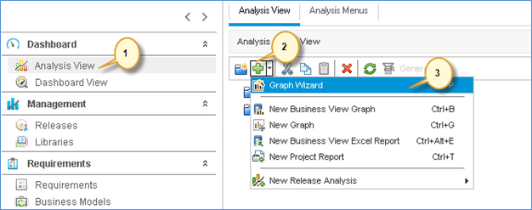
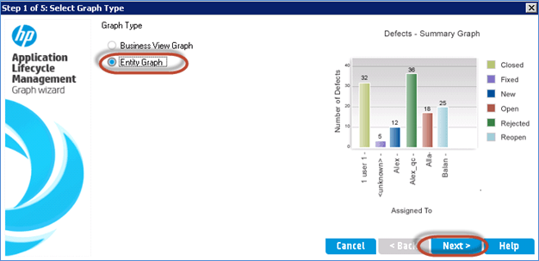
Analysis using Graphs – Create an Entity Graph
Notes:
Now, Let us generate an Entity Graph. For Example: Defect Summary Graph. Follow the steps mentioned to generate a Defect Summary Graph.
Step 1) Navigate to 'Dashboard' Tab on the left of the ALM side bar.
Click Analysis View.
Click New.
Select Graph Wizard from the drop-down list.
Step 2) Let us generate 'Entity Graph'. We can also generate a Business View Graph and click Next.
Step 3) The "Select Entity Type" Dialog is displayed to the user.
Select the entity for which the Graph has to be displayed.
Select the Graph type.
Click Next.

Slide 28
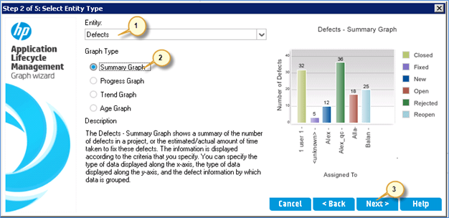
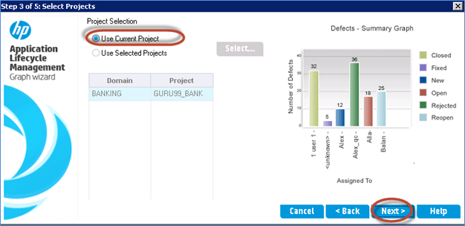
Analysis using Graphs – Create an Entity Graph (Contd.)
Notes:
Step 4) The Wizard allows you to choose projects. You have the capabilities to add the same graph configuration across projects.

Slide 29
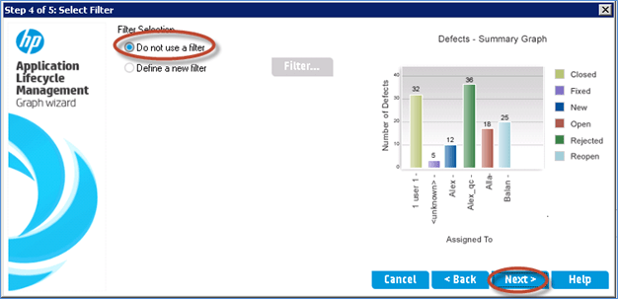
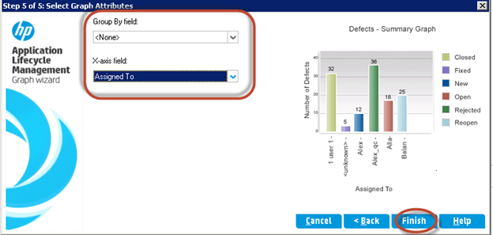
Analysis using Graphs – Create an Entity Graph (Contd.)
Notes:
Step 5) The Wizard also allows you to enter a filter criterion. If there is NO Filter applied, the graph is generated by considering all the data available in Defects module.
Note: Filter can be applied against a specific release/cycle. If NO Filter is set, the graph wizard picks up all the defects that are posted till date into consideration.
Step 6) The Wizard allows you to choose X-Axis and Group by a certain field and click Finish.

Slide 30
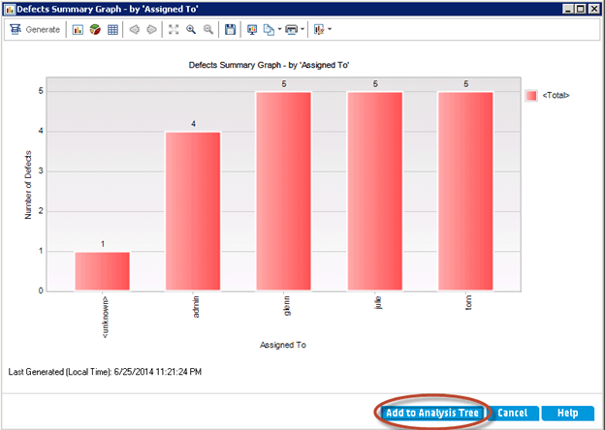
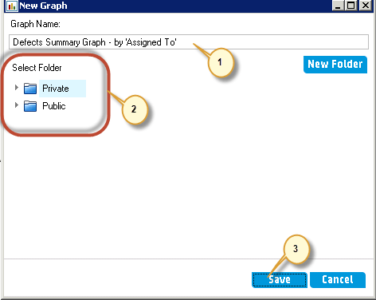
Analysis using Graphs – Create an Entity Graph (Contd.)
Notes:
Step 7) The graph is generated as per the criteria set by the user in Graph wizard. You can 'Add it to the Analysis Tree' so that we you just refresh the chart to get the current status.
Step 8) Upon clicking on 'Add to Analysis Tree' the save dialog opens up.
1. Enter the Name of the Graph.
2. Select the folder where user would like to save the Graph.
Private – The Graph is saved against the current user profile. Others won't have access to the same.
Public – The generated Graph would be visible to ALL the project users.
3. Click Save.

Slide 31
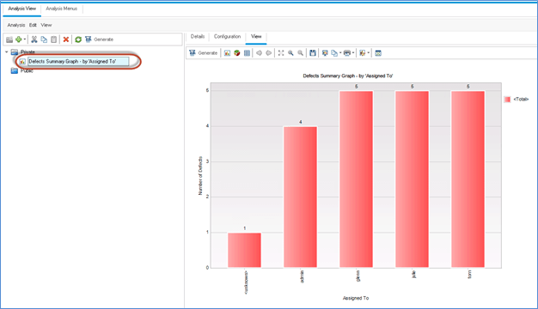
Analysis using Graphs – Create an Entity Graph (Contd.)
Notes:
Step 9) The graph is added to the Analysis tree as shown on the slide.

Slide 32
Share a Graph or a Project Report for view outside ALM
You can allow ALM users or others to view read-only versions of graphs outside ALM. Each time
you access the graph outside ALM, it displays the most up-to-date information
You can share a graph or a project for view outside ALM Client
Notes:
You can allow ALM users or others to view read-only versions of graphs outside ALM. Each time you access the graph outside ALM, it displays the most up-to-date information. You can share a graph or a project for view outside ALM Client This option is not available in the Analysis Menus tab. To share a Graph or Project Report, right click a graph or project report in the analysis tree and Select a Share Analysis Item.
In this exercise, you will share the Defects Summary graph you have created in Generating Entity Graphs in the Analysis View Module exercise.
To share a graph:
1. Display the Analysis View module.
On the ALM sidebar, under Dashboard, select Analysis View.
2. Share the Defects Summary graph.
a. In the Private folder, under My_Analysis_Items, select Defects Summary Graph -
Group by ‘Priority’.
b. Right-click and select Share Analysis Item. The Share Analysis Item dialog box opens.
Select Copy Analysis Item Public URL. This option allows others to view the graph
without entering ALM user credentials.
d. Click OK. A URL of the graph is saved to the clipboard.
3. View the graph outside ALM.
Let us understand the different options available in the Share Analysis item dialog box as shown in the figure.
Copy Analysis Item URL (Authentication Required) Copies a URL of the selected graph or report to the clipboard.
You are required to enter an ALM user name and password to view the graph or report.
Copy Analysis Item Public URL Copies a URL of the selected graph or report to the clipboard.
No authentication is required.
Reset Analysis Item Public URL If you previously selected Copy Analysis Item Public URL, selecting this option blocks access to the public read-only version of the selected graph or report.

Slide 33
Analysis using Graphs – Business View Graph
Business View Graph:
A business view graph involves only those project entity fields that represent information which is useful from a business perspective.
Business views can either be based on single entities such as Requirement or Defects, or it can be based on more complex relationships between entities such as Defects with Linked Requirements/defects with linked tests.
Though on a high level, both business view graph and entity graph look at the same, at this juncture let us understand basic different between entity graph and business view graph.
Entity Graph | Business View Graph
This graph is strictly associated with only one type of entity (Requirement / Test / Defect) in ALM | This graph is either based on single entity or based on relationship between defects and requirement or defects and tests.
The fields involved are those that are contained with in that specific entity | The fields involved are those that represent useful information from a business perspective
Notes:
Now, Let us know what is a business view graph and when do you use business view graphs.
A business view graph involves only those project entity fields that represent information which is useful from a business perspective.
Business views can either be based on single entities such as Requirement or Defects, or it can be based on more complex relationships between entities such as Defects with Linked Requirements/defects with linked tests.
Though on a high level, both business view graph and entity graph look at the same, at this juncture let us understand basic different between entity graph and business view graph.
Before, we get into the demonstration of how to create a business view graph. Let us understand the differences and when an entity graph is used versus a business view graph.
Entity Graph is strictly associated with only one type of entity (such as requirements or tests or defects) in ALM where as business view graph is either based on a single entity or based on the relationship between several entities such relationship between defects and requirements or another example could be defects and tests.
In case of entity graphs, the field involved are specific to the entity where as in business view graphs, the fields involved are those that represent useful information from a business perspective.

Slide 34
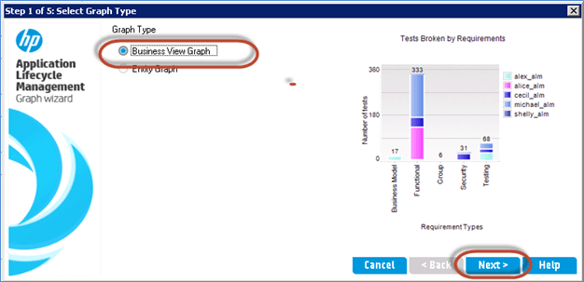
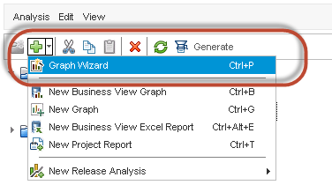
Analysis using Graphs – Create a Business View Graph
Notes:
Step 1) Click '+' and then select 'Graph Wizard'.
Step 2) Select the Business View Graph option and click Next.

Slide 35
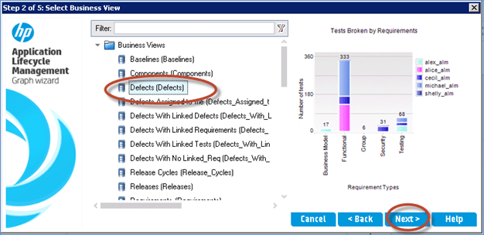
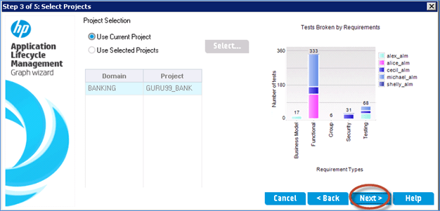
Analysis using Graphs – Create a Business View Graph (Contd.)
Notes:
Step 3) Select Defects (Defected) from the Filter criteria and click Next.
Step 4) Use the current project data to generate the graph and click Next to continue.

Slide 36
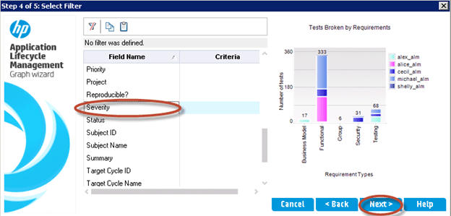
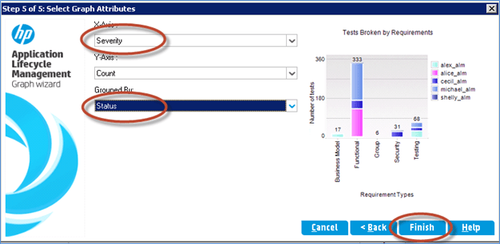
Analysis using Graphs – Create a Business View Graph (Contd.)
Notes:
Step 5) Let us filter based on Severity and click Next.
Step 6) Type the criteria for 'X-Axis' and Grouped By fields and Click Finish.

Slide 37
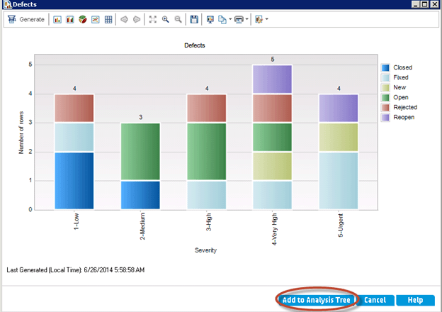
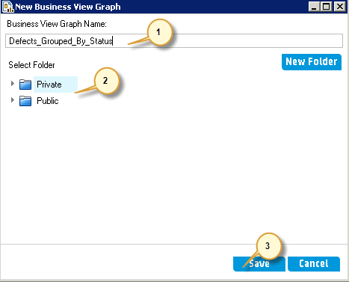
Analysis using Graphs – Create a Business View Graph (Contd.)
Notes:
Step 7) The Graph is Generated based on the Criteria selected. Click Add to Analysis Tree.
Step 8) The save dialog appears for users to save the generated graph.
1. Enter the Name of the Graph.
2. Select either Private or Public.
3. Click Save.

Slide 38
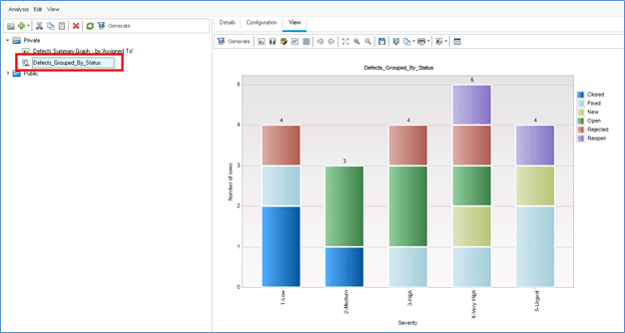
Analysis using Graphs – Create a Business View Graph (Contd.)
Notes:
Step 9) The created graph is saved in Analysis Tree as shown on slide.

Slide 39
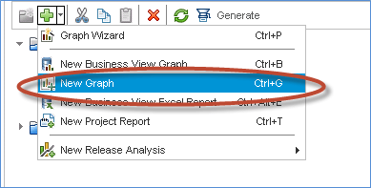
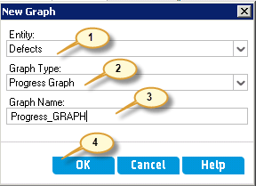
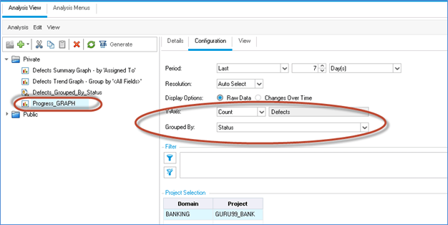
Analysis using Graphs – Another Approach to Create an Entity Graph
Notes:
Quick Entity Graphs Generation:
Step 1) The Entity Graph can also be generated without going through the Graph Wizard. A Quick Graph can be generated by clicking on 'New Graph' by clicking on '+' icon.
Step 2) The New Graph dialog is displayed.
1.Select the Entity, Graph Type, and Graph Name
2. Click OK.
Step 3) The Created Graph enables users to make changes to the Configuration based on their requirements. You have selected the Defect Count on Y Axis and Grouped based on Status.

Slide 40
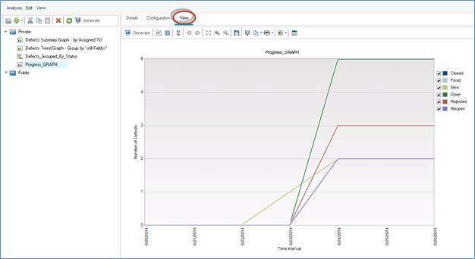
Analysis using Graphs – Another Approach to Create an Entity Graph
Notes:
Step 4) Click the View tab to generate the graph for the specified criteria.

Slide 41
Learning Objective
Learning Objectives
After completing this learning component, you will be able to:
ALM Tool – Overview
ALM supports through all phases of Application Life Cycle Management
Release and Test Cycle Management
Requirement Management and Test Planning
Test Execution and Defect Management
Explain the Analysis Overview
Define Graphs Analysis
Explain Excel Reports
Data Analysis via reporting and Dashboard Feature of ALM
What is HP Sprinter
Test Execution
Screen Annotation & Tools
Defect logging from Sprinter
Power Mode Features
Indicates the topic in discussion
Indicates the topics to be covered
Indicates the topics covered
Notes:
The topic ‘Introducing Analysis’ will give you brief an introduction to analysis before get to know what the different analysis tools and their usages are.

Slide 42
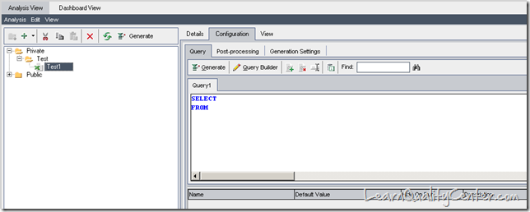
Customized Excel Reports
Customized Excel Reports
Notes:
Customized Excel Reports :
Dashboard Module enables a user to create customized reports. Knowledge of SQL and VB Scripting is required, as queries should be written in SQL for fetching the details of various modules in ALM.
1) Prerequisite is Verify supported Version of Excel compatible with ALM is installed.
2)Add an excel Report to the analysis tree.
a) Open the Analysis View Module - On the ALM side bar, under Dashboard, Select Analysis View
b) Add a folder to the analysis tree - Right-click a folder under the Private or Public folder and select New Folder
c) Create a New Excel Report – Right Click a Folder, and select New Excel Report. Enter a name for the excel report in the New Excel Report dialog box.
Once the user clicks on OK a new blank report is created under the Test folder as shown above.
The user can view three options on the menu bar Details , Configuration and View
Details – This tab contains the name of the new report, Owner, Type of report and so on.
Configuration – This tab contains the actual query, Post Processing section and all the other options for generating the report.
View – This tab contains the data and the report results of the report generated.

Slide 43
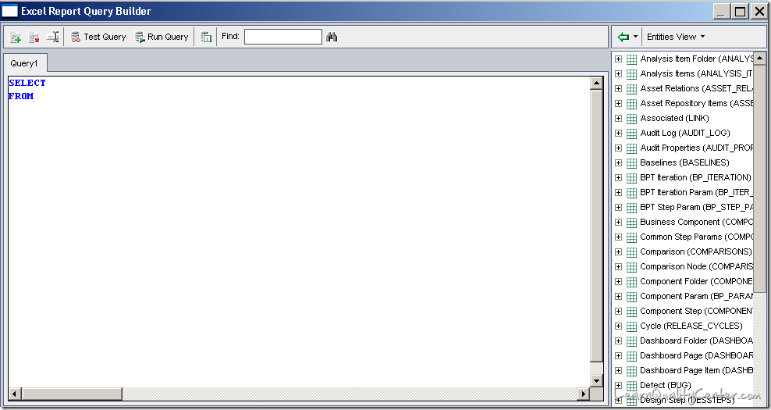
Customized Excel Reports (Contd.)
Notes:
Under the Configuration tab we have three more sub tabs as mentioned below.
Query – Here the user can write SQL queries for every module.
Post Processing – The user needs to write VB Scripts for getting the data received from the queries in a readymade fashion. For Example: If you have a query to get the defects logged by him/her but when the user runs the query an excel sheet is generated which gives data in a raw format. But with Post processing section a user can readily get the count of the defects logged without filtering the data in the excel sheet.
Generation Settings – This tab gives you the information about the path where the reports will be saved.
Click on “Query Builder” option present beside the Generate tab. The following tab opens as shown below.
The Entities present on the right hand side of the window are the table names and the corresponding field names. The user should pull the required table name and the fields required for generating the report.

Slide 44
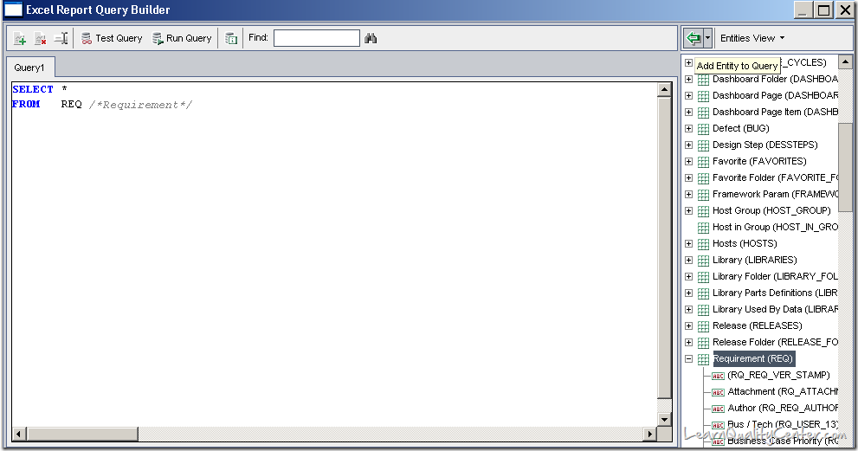
Customized Excel Reports (Contd.)
Notes:
As per the snap shot above, you have selected *(select all the fields from the table name) from Requirements table name which pops-up all the field names present in the Requirements module.

Slide 45
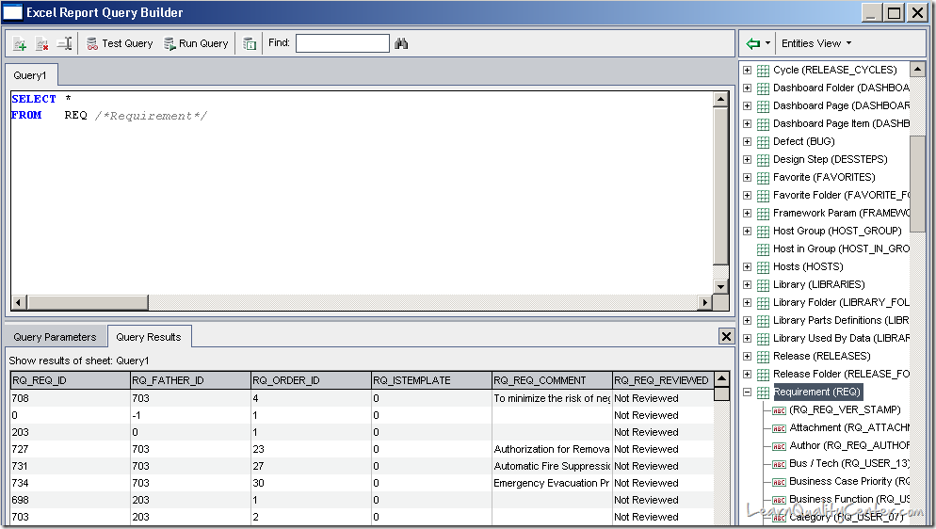
Customized Excel Reports (Contd.)
Notes:
Once you click the “Run Query” the Query builder runs the query and gives the results to the user as shown on the slide.
You can create multiple queries in an Excel report. When you generate the report, the results of each query are displayed in separate Excel worksheets.
You can perform the following operations:
Add Query – A User can add multiple queries by clicking on this option for different modules.
Delete Query – A user can delete the existing queries.
Rename Query – A query can be renamed by clicking on this option.
Test Query – This option is used to test a query for a limited set of values (max 10).
Run Query – This option is used to test a query for all the values present in the particular module.
You can define parameters in an SQL query. You can use parameters in SQL queries to modify the results of an Excel report, based on parameter values that you enter. In the Query Builder dialog box, use the buttons in the Query Parameters tab.

Slide 46
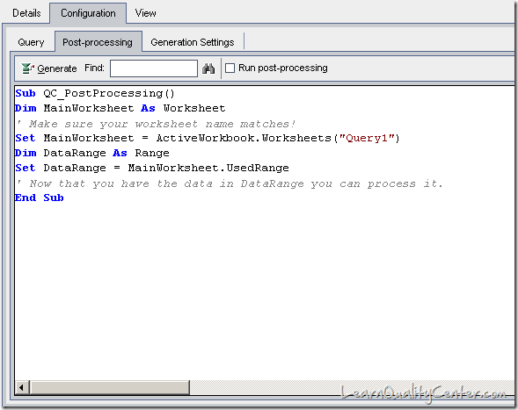
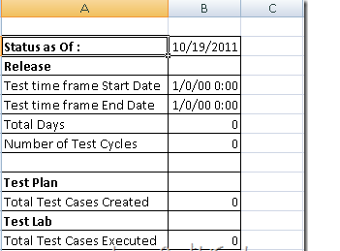
Customized Excel Reports (Contd.)
Notes:
4) Create a Post Processing Script.
You can create a Visual Basic script to run after the data is exported to Excel. You use this script to manipulate the data in Excel.
For example, you can present requirements data in Excel as a pivot table, you could perform calculations on defects data to calculate the average time an open defect takes to be fixed, or you could create a graph based on exported data.
In the Configuration tab, click the Post-processing tab. Write a Visual Basic script
When writing a post-processing script, consider the following guidelines:
Your post-processing script must contain a sub-procedure named QC_PostProcessing. This procedure serves as the entry point to your script. This procedure cannot return a value and cannot take any arguments.
Before you can work with the report data in Excel, you must first define the range containing the report data. You define this range in two steps:
You first define the worksheet containing the report data by creating a worksheet object containing the data. For example, if the worksheet is named Query1, you can use the statement Set MainWorksheet = ActiveWorkbook.Worksheets("Query1").
After you define the worksheet containing the report data, you define the range containing the data by creating a range object containing the data. For example, if you defined the worksheet object with name MainWorksheet, you can use the statement Set DataRange = MainWorksheet.UsedRange.
After you define this range, you can manipulate the data contained in it using Visual Basic code.
Before you run a post-processing script, you must configure your Microsoft Excel security settings so that Excel can run the script
5) Generate an Excel Report.
Generating an Excel report extracts the data you specified in the SQL queries from the project database, saves the data in an Excel workbook, and runs the post-processing script.
In the Configuration tab, click the Generation Settings tab. Set options for running an Excel report. For user interface details, refer the Generation Settings tab,
Click Generate.
This is a sample report generated after inputting the query and the writing a VB script in the post processing section.

Slide 47
Learning Objective
Learning Objectives
After completing this learning component, you will be able to:
ALM Tool – Overview
ALM supports through all phases of Application Life Cycle Management
Release and Test Cycle Management
Requirement Management and Test Planning
Test Execution and Defect Management
Explain the Analysis Overview
Define Graphs Analysis
Explain Excel Reports
Data Analysis via reporting and Dashboard Feature of ALM
What is HP Sprinter
Test Execution
Screen Annotation & Tools
Defect logging from Sprinter
Power Mode Features
Indicates the topic in discussion
Indicates the topics to be covered
Indicates the topics covered
Notes:
The topic ‘Introducing Analysis’ will give you brief an introduction to analysis before get to know what the different analysis tools and their usages are.

Slide 48
ALM Capabilities – Analysis using Entity Graphs
Entity Graphs Analysis :
Notes:
ALM enables users to generate graphs for requirements, tests, test instances, test runs or defects. When creating an entity graph, you can use several graph types.
You can generate the following graphs for requirements :
Requirements Coverage Graph
Requirements Progress Graph
Requirements Summary Graph and
Requirements Trend Graph
You can generate the following graphs for Tests:
Test Plan Progress Graph
Test Plan Summary Graph
Test Plan Trend Graph
You can generate the following graphs for test instances and runs
Test Set Progress Graph
Test Set Summary Graph
Test Run Summary Graph
You can generate the following graphs for Defects
Defects Age Graph
Defects Progress Graph
Defects Summary Graph
Defect Trend Graph
ALM reports and graphs help you assess your application lifecycle management process. You can
generate reports and graphs at any time during the process.

Slide 49
ALM Capabilities – Analysis using Business View Graphs
Business View Graphs Analysis :
Notes:
A business view graph involves only those project entity fields that represent information which is useful from a business perspective.
Business views can either be based on single entities such as Requirement or Defects, or it can be based on more complex relationships between entities such as Defects with Linked Requirements/defects with linked tests.
ALM enables you to generate a business view graphs.

Slide 50
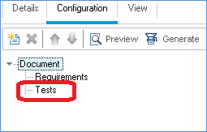
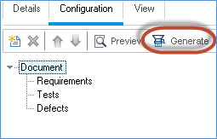
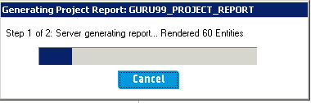
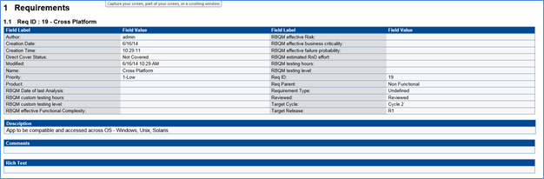
ALM Capabilities – Analysis using Project Reports
Project Reports Analysis :
Notes:
Project reports enable you to design and generate versatile reports containing information from the ALM project.
Project reports enable you to design and generate comprehensive reports containing information from your HP Application Lifecycle
In a project report, you define sections and sub-sections, each listing records of a specified ALM entity. You can choose to display data of a selected baseline
You can generate project reports in HTML, Microsoft Word, or PDF formats.
You can create graphs or project reports either in the Analysis View module, or during your work in the Requirements, Test Plan, Test Lab, Business Components, or Defects modules

Slide 51
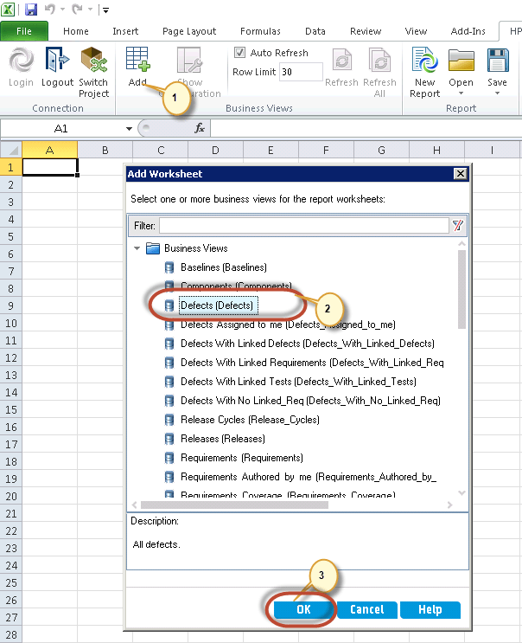
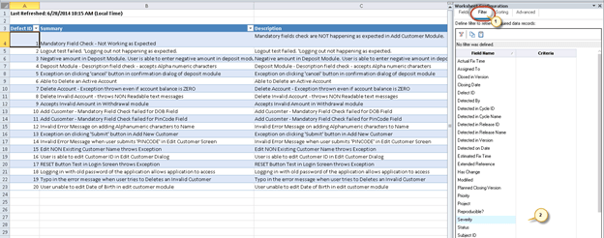
ALM Capabilities – Analysis using Excel Report
Excel Report Analysis :
Notes:
You can export HP Application Lifecycle Management (ALM) data to Microsoft Excel. This enables you to analyze your data using any of the capabilities available in Excel. An Excel report consists of a set of data defined by SQL queries on the project database. You can also run a Visual Basic script on the extracted data to process and analyze the data

Slide 52
Analysis using Customized Excel Reports
Customized Excel Report Analysis :
Notes:
Dashboard Module enables a user to create customized reports. Knowledge of SQL and VB Scripting is required, as queries should be written in SQL for fetching the details of various modules in ALM

Slide 53
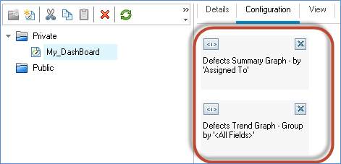
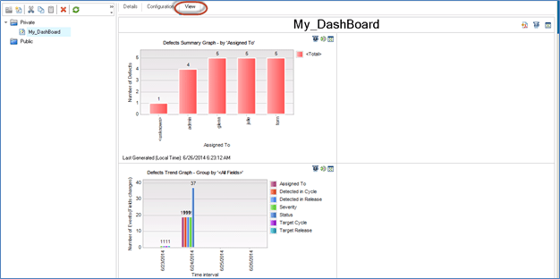
ALM Capabilities – Dashboard Page
Dashboard Page :
Notes:
Using the Dashboard View module, you analyse ALM data by creating graphs, project reports and Excel Reports. you can also create dashboard pages that display multiple graphs side-by-side in single view

Slide 54
ALM Capabilities – Share a Graph outside of ALM Client
Sharing Graph Outside ALM Client :
Notes:
You can allow ALM users or others to view read-only versions of graphs outside ALM. Each time
you access the graph outside ALM, it displays the most up-to-date information
You can share a graph or a project for view outside ALM Client

Slide 55
Learning Objective
Learning Objectives
After completing this learning component, you will be able to:
ALM Tool – Overview
ALM supports through all phases of Application Life Cycle Management
Release and Test Cycle Management
Requirement Management and Test Planning
Test Execution and Defect Management
Explain the Analysis Overview
Define Graphs Analysis
Explain Excel Reports
Data Analysis via reporting and Dashboard Feature of ALM
What is HP Sprinter
Test Execution
Screen Annotation & Tools
Defect logging from Sprinter
Power Mode Features
Indicates the topic in discussion
Indicates the topics to be covered
Indicates the topics covered
Notes:
The topic ‘Introducing Analysis’ will give you brief an introduction to analysis before get to know what the different analysis tools and their usages are.

Slide 56
Manual Testing Today
Manual testing has not changed in 15 – 20 years – It’s challenging
Executing Tests
Defect Remediation
QA Team
Development Team
Significant time spent executing tests
Bug descriptions are rarely complete
Following and executing test steps is challenging
Information needed to recreate the bug is often missing
Repetitive test steps waste execution time
Significant time spent trying to recreate and figure out defects
Test multiple environments is time consuming
No history of user actions when exploratory testing
Entering data is a chore and can be error prone

Slide 57
What is HP Sprinter?
HP Sprinter provides a suite of advanced features and tools that make manual testing more efficient and effective.
Sprinter displays steps in a clear, organized, and user-friendly design.
Sprinter enables you to create annotated screen captures of your application and attach them to an ALM defect or the actual result of a step. You can also attach a movie of your run to a defect in ALM.
Sprinter can keep a record of all the user actions you performed during your test.
This enables Sprinter to create detailed defect scenarios for you.
This greatly increases the value of exploratory tests that you run without pre-defined steps.
Sprinter can inject data automatically into fields in your application.
Sprinter enables you to create and run macros to perform a set of actions in your application for you.
Sprinter can replicate your user actions on multiple computers with different configurations. This allows you to increase your coverage matrix and saves you time testing different configurations.
Notes:
HP Sprinter provides a suite of advanced features and tools that make manual testing more efficient and effective.
Sprinter displays steps in a clear, organized, and user-friendly design.
Sprinter enables you to create annotated screen captures of your application and attach them to an ALM defect or the actual result of a step. You can also attach a movie of your run to a defect in ALM.
Sprinter can keep a record of all the user actions you performed during your test.
This enables Sprinter to create detailed defect scenarios for you.
This greatly increases the value of exploratory tests that you run without pre-defined steps.
Sprinter can inject data automatically into fields in your application.
Sprinter enables you to create and run macros to perform a set of actions in your application for you.
Sprinter can replicate your user actions on multiple computers with different configurations. This allows you to increase your coverage matrix and saves you time testing different configurations.

Slide 58
HP Sprinter Add-in
Hp Sprinter is not a module in ALM. It is a an additional feature which can be installed from the add-in page.
Editions:
HP ALM and HP Quality Center Enterprise Edition enable manual testing with Sprinter.
Sprinter is not available for HP Quality Center Starter Edition or HP ALM Performance Center Edition.
Download Link:
http://update.external.hp.com/qualitycenter/qc110/mictools/sprinter/index.html
Notes:
Hp Sprinter is not a module in ALM. It is a an additional feature which can be installed from the add-in page.
Editions:
HP ALM and HP Quality Center Enterprise Edition enable manual testing with Sprinter.
Sprinter is not available for HP Quality Center Starter Edition or HP ALM Performance Center Edition.
Download Link:
http://update.external.hp.com/qualitycenter/qc110/mictools/sprinter/index.html

Slide 59
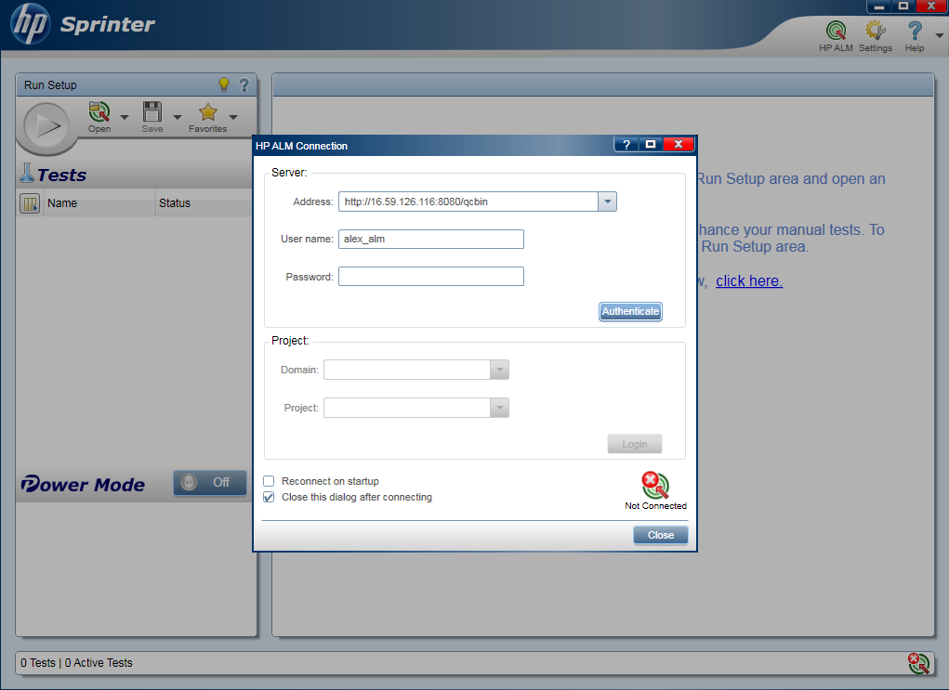
Connects directly to HP Quality Center
Open test cases from HP Quality Center
Connects directly to HP Quality Center
Included with HP Quality Center 11.0 and HP ALM 11.0
Save results directly into HP Quality Center

Slide 60
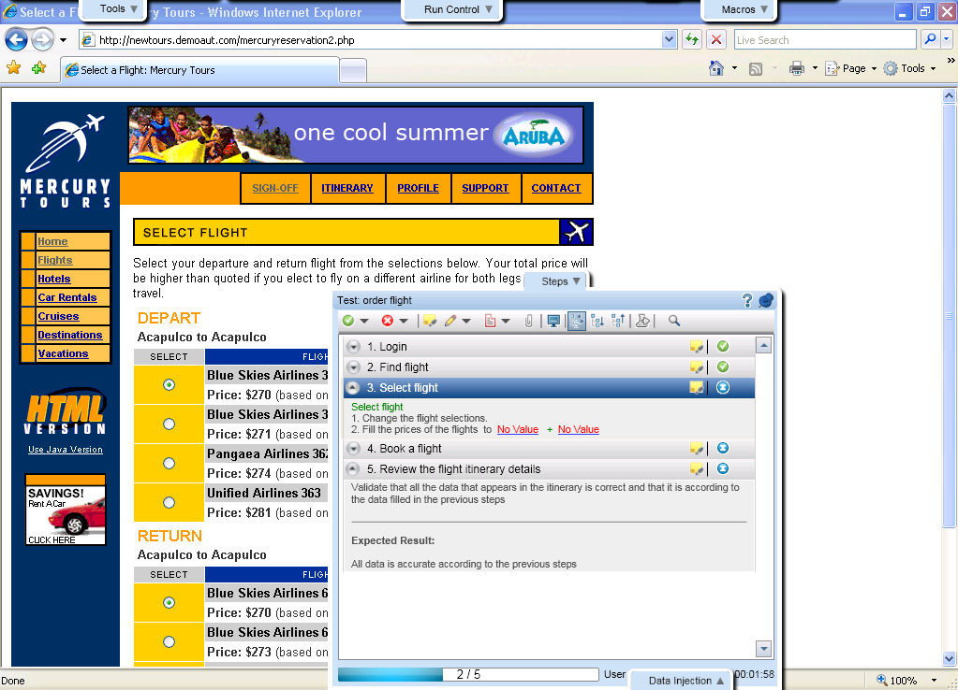
Test Execution
Tabs around application under test
Test steps for execution
Easy to use, unobtrusive and maximizes application under test real estate

Slide 61
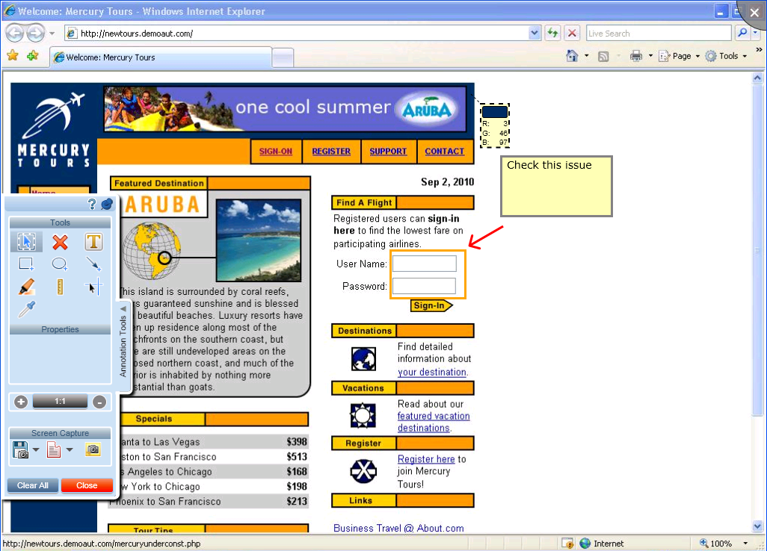
Screen Annotation and Tools
Annotation Tools
Check application elements
- color, position
Annotate directly on the screen
Clearly communicate defects to developers using visual tools

Slide 62
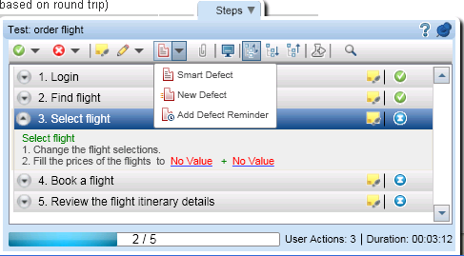


Log Defects in QC
Simply create a defect
Easily give developer the most possible information
Create defect without entering QC

Slide 63

Data Injection
Save significant time on most tedious manual testing activity
Automatically insert data into the application

Slide 64

Exploratory Testing
Create formal test script from exploratory test
Log user all actions performed during test
Communicate user actions taken clearly to development
Increase value of exploratory testing and improve communication of results
Notes:
Becoming more common with Agile adoption
Used to test how the software is working and handles different actions in order to uncover defects quickly
Challenge: The history or actions that led to that outcome cannot be communicated as the test was ad-hoc and wasn’t following a specific test case or use case
With HP Sprinter:
You can keep a record and log of all the user actions you performed during your test
Increase the value of exploratory testing by better communicating what lead to the result or defect

Slide 65





Mirror Testing
Test multiple environments at the same time
vmftrnd3
vmftrnd42

Slide 66
Source
Reference Websites:
http://www.tutorialspoint.com/qc/qc_quick_guide.htm
http://www.guru99.com
http://www.learnqualitycenter.com/
Reference Books:
ALM Tutorial
ALM User Guide
ALM Help Online
Disclaimer: Parts of the content of this course is based on the materials available from the Web sites and books listed above. The materials that can be accessed from linked sites are not maintained by Cognizant Academy and we are not responsible for the contents thereof. All trademarks, service marks, and trade names in this course are the marks of the respective owner(s).
Notes:
<Please recommend the pictures and animations for ID designers>

Slide 67
ALM – Overview of All Modules
Thank You!
Notes:
You have completed the session on “ALM – Overview of All Modules”. Thank You!

